Slide 1
Linear Filters
Introduction

Slide 2
Linear Filters
Filter
Setting
Filter
(Input)
(Output)
Examples
Difference:
5-point moving average smoother:

Slide 3
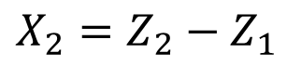
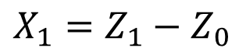
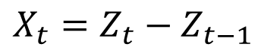
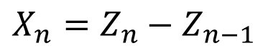
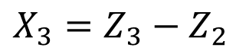
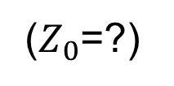
Filter Example: Difference
Consider the series: Z₁ = 8, Z₂ = 14, Z₃ = 14, Z₄ = 7
The difference Filter
Differenced data
$$X_{t}=Z_{t}−Z_{t−1}$$
$$X_{1}=Z_{1}−Z_{0}$$
($Z_{0}$=?)
$$X_{2}=Z_{2}−Z_{1}$$
$$X_{3}=Z_{3}−Z_{2}$$
.
.
.
Note:
The differenced data (Z_{t}) are a realization of length n − 1.
$$X_{n}=Z_{n}−Z_{n−1}$$

Slide 4
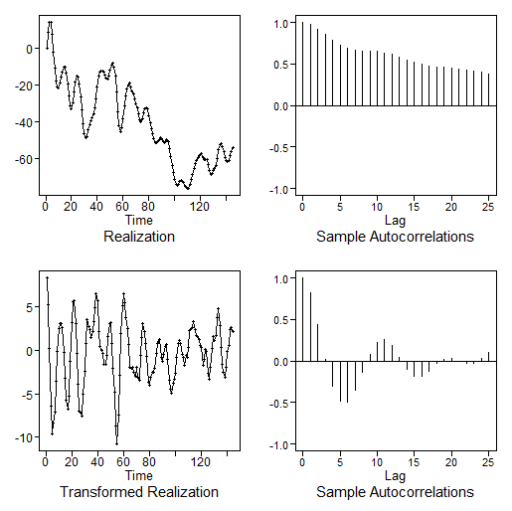
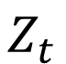
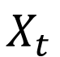
Original data
$$Z_{t}$$
Differenced data
$$X_{t}$$
Difference removes long-term trending behavior and retains a (monthly) cyclic pattern.

Slide 5
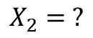
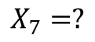
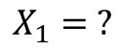
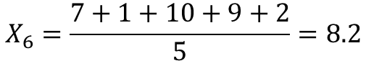
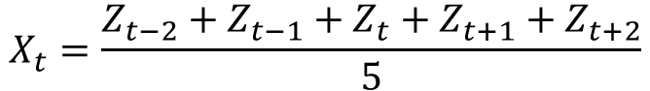
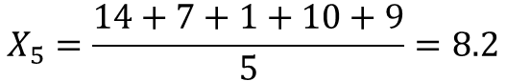
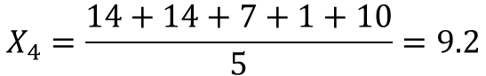
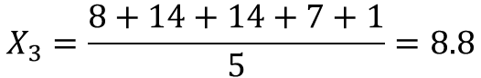
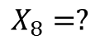
Filter Example: 5-Point Moving Average
Consider the series:
Z₁ = 8, Z₂ = 14, Z₃ = 14, Z₄ = 7, Z₅ = 1, Z₆ = 10, Z₇ = 9, Z₈ = 2
$$X_{t}=\frac{Z_{t−2}+Z_{t−1}+Z_{t}+Z_{t+1}+Z_{t+2}}{5}$$
The 5-point moving average filter
$$X_{1}= ?$$
$$X_{5}=\frac{14+7+1+10+9}{5}=8.2$$
$$X_{2}= ?$$
$$X_{6}=\frac{7+1+10+9+2}{5}=8.2$$
$$X_{3}=\frac{8+14+14+7+1}{5}=8.8$$
$$X_{7}=?$$
$$X_{4}=\frac{14+14+7+1+10}{5}=9.2$$
$$X_{8}=?$$
Note:
The differenced data (Z_{t}) are a realization of length n−4.

Slide 6
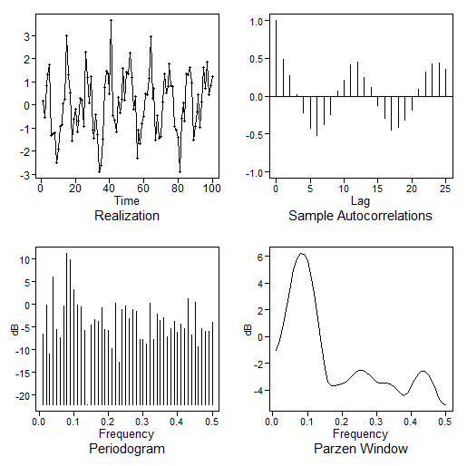
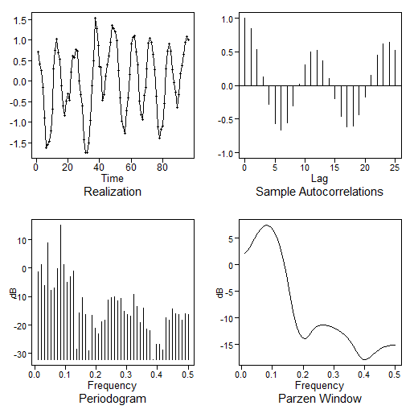
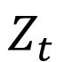
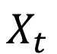
Sine + noise signal
$$Z_{t}$$
Signal above after applying 5-point moving average smoother
$$X_{t}$$

Slide 7
Filters are sometimes used to “filter out” certain frequencies from a set of data.
Types of filters
Low-pass filters:
“Pass” low-frequency behavior and “filter out” higher-frequency behavior
The 5-point moving average smoother is a low-pass filter
High-pass filters:
“Pass” high-frequency behavior and “filter out” lower-frequency behavior
A difference is a high-pass filter
See text for other types of filters.
Notes:
Do we want to do something with the King Kong Data Here?

Slide 8
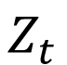
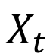
Original data
$$Z_{t}$$
Low or high pass?
Differenced data
High pass!
$$X_{t}$$
Difference removes long-term trending behavior and retains a (monthly) cyclic pattern.

Slide 9
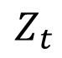
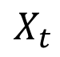
Sine + noise Signal
$$Z_{t}$$
Low or high pass?
Low pass!
Signal above after applying 5-point moving average smoother
$$X_{t}$$
The 5-point moving average filter removes high-frequency behavior and retains the lower frequency signal.

Slide 10
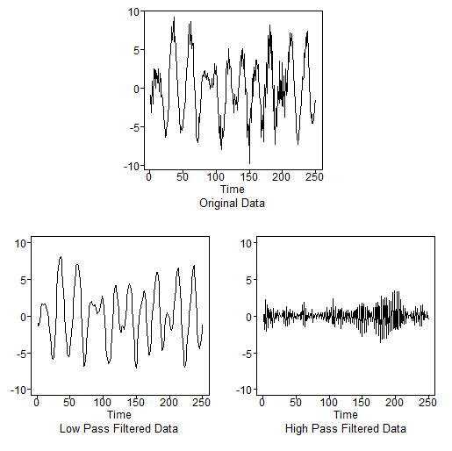
Recall: Data with Two Frequencies
Spectral density showing frequencies at about .05 and .35
That is, the time series has cycles of length about 20
and 3.

Slide 11
Original Data Containing Two Frequencies
Data (Fig. 1.21a)
Low-pass filtered data
High-pass filtered data
ma = filter(fig1.21a,rep(1,5))/5
plot(ma,type = “l”)
dif = dif(fig1.21a,lag = 1)
plot(dif,type = “l”)

Slide 12
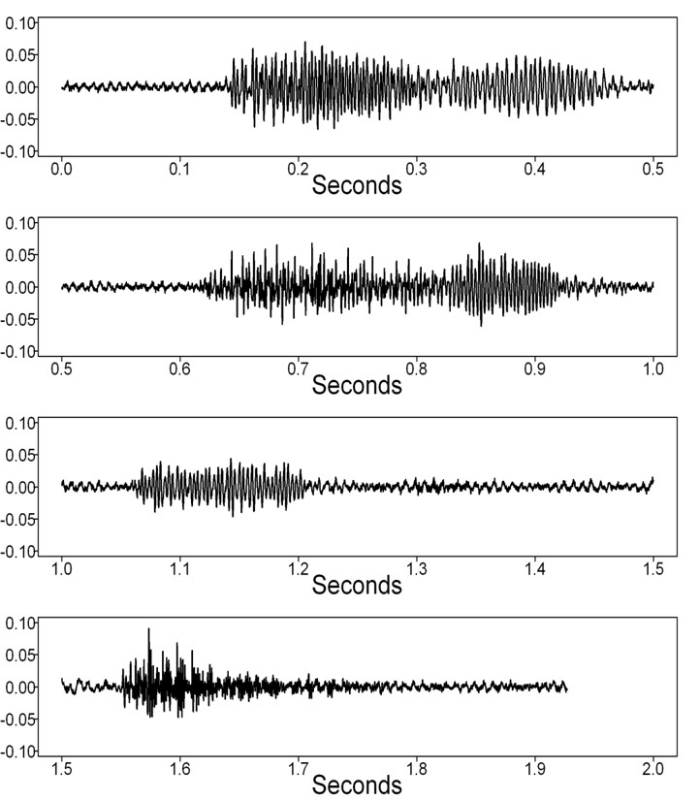
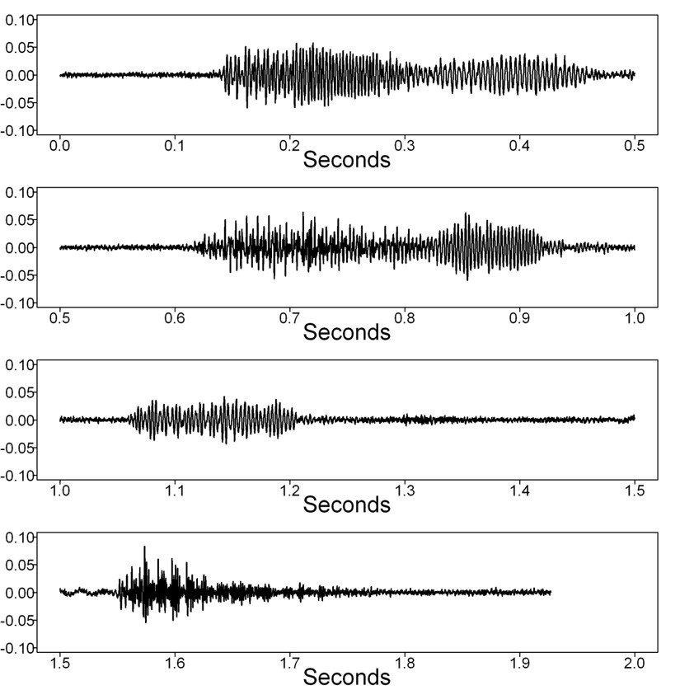
King Kong eats grass (with fan noise)
Filtered KK eats grass (fan noise filtered out)
Low-Pass Filtered Data
High-Pass Filtered Data
Notes:
I love this example, but I don’t see much of a difference. If you look close though … it is clearly there.

Slide 13
Let’s Try One!
Given the plot of the realization and the plot of the filtered data below, which was the result of the low-pass filter?
Realization = gen.sigplusnoise.wge(200,coef = c(5,3),freq = c(.1,.45), vara = 10, sn = 1)
A
B

Slide 14
Let’s Try One!
Given the plot of the realization and the plot of the filtered data below, which was the result of the low-pass filter?
Realization = gen.sigplusnoise.wge(200,coef = c(5,3),freq = c(.1,.45), vara = 10, sn = 1)
A
B
ma = filter(Realization,rep(1,5))/5 plot(ma,type = "l") parzen.wge(ma[is.na(ma)])
dif = diff(Realization,lag = 1) plot(dif,type = "l") parzen.wge(dif[is.na(dif)])

Slide 16
General Linear Process (GLP)

Slide 17
Possibly real-world example
Mikio slide with “filtering”
Feature engineering/cleaning
Response cleaning?
Wayne had another idea I forgot about. (It may have been the response cleaning.)
Maybe an interview if we can find one. Greg and Smart cover?
Also… live session… introduce Butterworth Filter exercise.

Slide 18
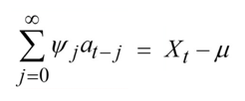
General Linear Process (GLP)
Before discussing autoregressive (AR) processes, moving average (MA), and autoregressive-moving average (ARMA) processes, we briefly introduce the general linear process.
A GLP is a linear filter with white noise input.
a_{t}
Filter
X_{t}
(Input)
(Output)
=

Slide 19
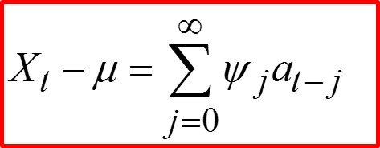
General Linear Process (GLP)
A GLP is an infinite linear combination of white-noise terms.
Expressed mathematically as:
X_{t}
Filter
a_{t}
AR, MA, and ARMA processes are all special cases of GLPs.
This will be very useful later when we study confidence intervals for forecasts.
See Woodward et al. (2017) for details.

Slide 21
AR(1) | Introduction and Key Result

Slide 22
Autoregressive (AR) Models
In this unit, we will introduce and study the well-known autoregressive (AR) models.
Possibly Interview Here (or somewhere soon)? Describing the use in industry of Autoregressive models.
Also…Shall we mention that the AR is a Linear Filter? add a graphic?
AR Model
(Input)
(Output)
Notes:
CHANGED… TOOK OFF MA AND ARMA

Slide 23
Autoregressive Models
AR(p) p = 1
In this unit, we will introduce and study the well-known autoregressive (AR) models.
Autoregressive models tend to be very useful for describing stationary data that move forward in time.
We start with the simplest AR model, the AR(1).
Notes:
Chuiping developed discrete Euler processes in 2002. This process has a close relationship with Autoregressive model. That is, the present value has linear relationship with past p values. However, the time points are different. AR(p) process has k, k-1… time points but.. EAR process has h to the power k…
If we take log bas h transformation on time, the EAR process become AR process
EAR has linear multiplicative values

Slide 24
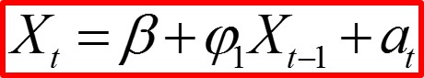
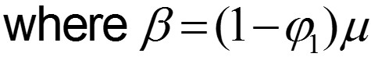
Autoregressive Model of Order 1: AR(1)
Notes:
β is called the moving average constant.
The AR(1) model says that the value of the process at time t (i.e., X_{t}) depends on the value of the process at time t − 1 plus a random noise component (and a constant).
This is a sensible way to describe the way a time series might progress in time.
This is similar to the simple linear regression model, but in this case, the “independent variable” is a value of the dependent variable at a prior time period.
Notes:
Chuiping developed discrete Euler processes in 2002. This process has a close relationship with Autoregressive model. That is, the present value has linear relationship with past p values. However, the time points are different. AR(p) process has k, k-1… time points but.. EAR process has h to the power k…
If we take log bas h transformation on time, the EAR process become AR process
EAR has linear multiplicative values

Slide 25
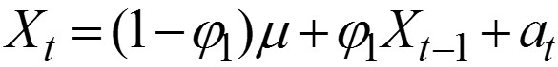
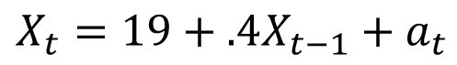
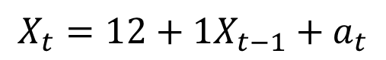
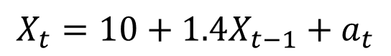
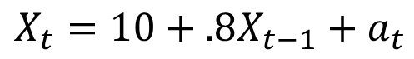
AR(1) model:
Key result
Examples
Stationary
Not stationary
$$X_{t}=10+.8X_{t−1}+a_{t}$$
$$X_{t}=10+1.4X_{t−1}+a_{t}$$
$$X_{t}=19+.4X_{t−1}+a_{t}$$
$$X_{t}=12+1X_{t−1}+a_{t}$$
Notes:
ADDED THE TWO COLUMNS STATIONARY AND NOT STATIONARY

Slide 27
AR(1) | Conditions 2 and 3
Variance and Autocorrelations

Slide 28
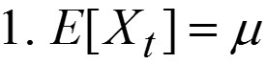
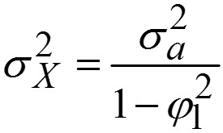
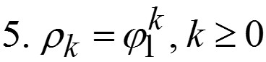
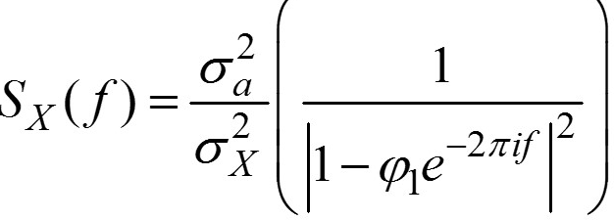
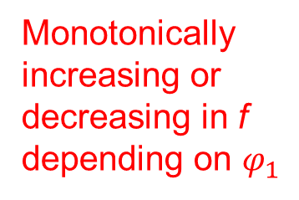
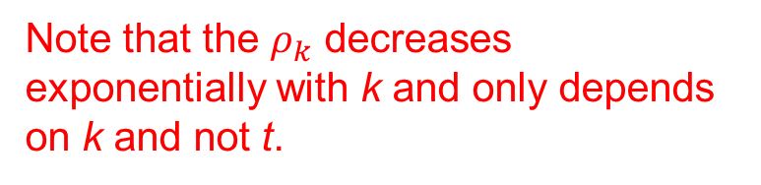
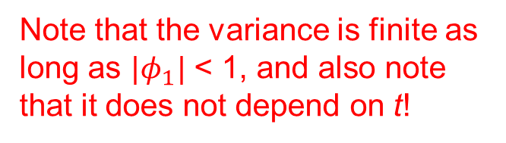
Stationary AR(1): Conditions 1, 2, and 3
Condition 1: Expected value
Mean does not depend on t.
Condition 2: Variance
Note that the variance is finite as long as ${|φ}_{1}|$ < 1, and also note that it does not depend on t!
Condition 3: Autocorrelations
Note that the $ρ_{k}$ decreases exponentially with k and only depends on k and not t.
Bonus: Spectral density
Monotonically increasing or decreasing in f depending on $φ_{1}$
Notes:
!!!MAYBE ADD IN BONUS / EXTRA MATERIAL TO INTRODUCE GLP AND THUS THE JUSTIFICATION FOR THE ABOVE RESULTS.

Slide 30
AR(1) | Zero Mean Form

Slide 31
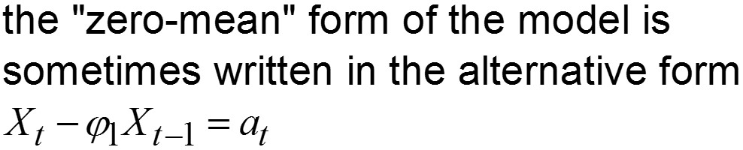
Stationary AR(1) Facts
this is called the “zero mean” form of the model, and we sometimes use it for convenience
•
Notes:
DELETED 3 SINCE IT IS ON THE NEXT SLIDE.

Slide 33
AR(1) | Backshift Operator

Slide 34
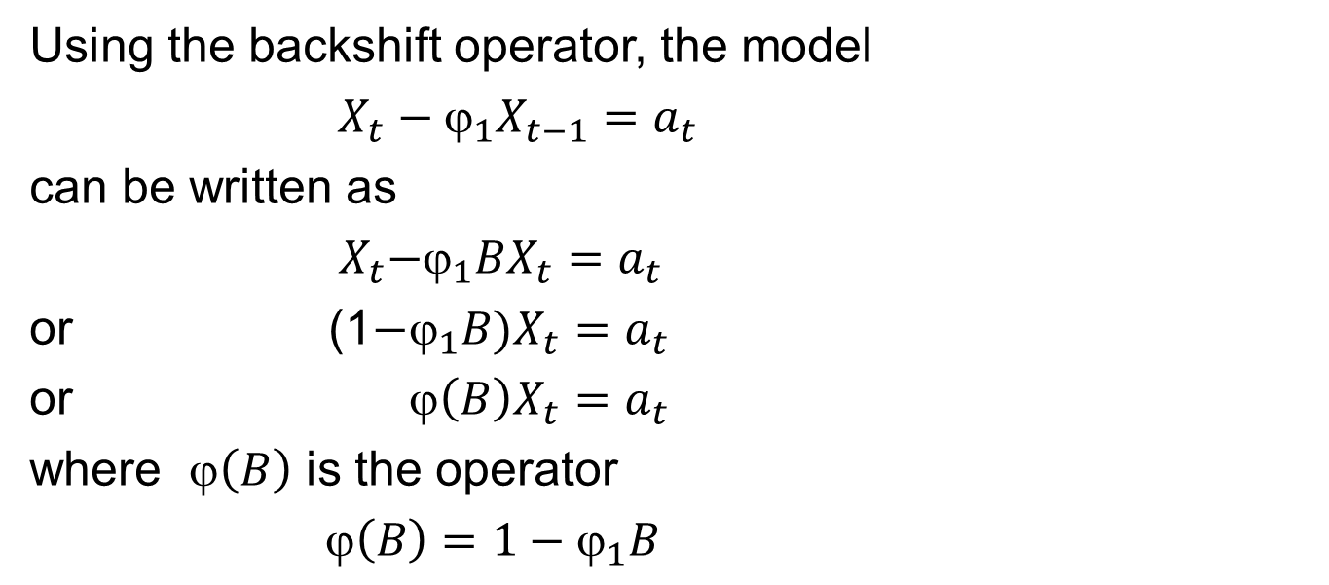
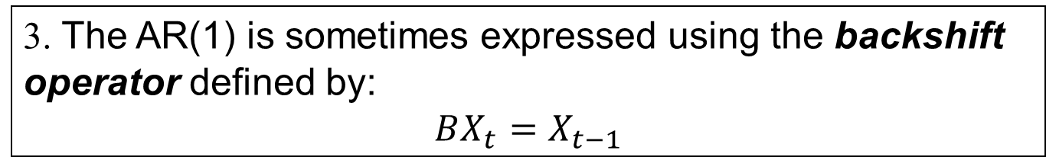
Stationary AR(1) Facts
3. The AR(1) is sometimes expressed using the backshift operator defined by:
$$BX_{t}=X_{t−1}$$
Using the backshift operator, the model
$X_{t}−_{1}X_{t−1}=a_{t}$
can be written as
${ X}_{t}−_{1}BX_{t}=a_{t}$
or (1$−_{1}B)X_{t}=a_{t}$
or ϕ$\left(B\right)X_{t}=a_{t}$
where $\left(B\right)$ is the operator
$\left(B\right)=1−ϕ_{1}B$

Slide 36
AR(1)
ϕ₁ Positive

Slide 37
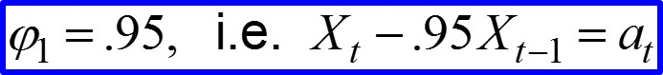
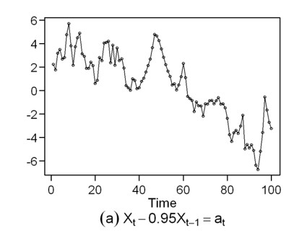






AR(1) Models: ϕ₁ Positive
Data
Autocorrelations
Spectral density
Data
Autocorrelations
Spectral density

Slide 38
AR(1) Models: ϕ₁ Positive
Summary
Realizations seem to be “wandering,” aperiodic in nature.
Autocorrelations are damped exponentials.
Spectral densities have peaks at f = 0, which is consistent with the behavior of the realizations.

Slide 39
Example: DOW Jones Industrial Average

Slide 40


DOW Jones Average over Two Consecutive 100-Day Periods
Dow Jones average
Autocorrelations
Spectral density
Dow Jones average
Autocorrelations
Spectral density
Note: Both data sets have characteristics similar to an AR(1) with $_{1}$≈.95.
Notes:
GREAT!!! LOVE THIS!

Slide 42
AR(1)
ϕ₁ Negative

Slide 43
AR(1) Models: ϕ₁ Negative
Summary
Realizations seem to be “oscillating,” that is, if X_{t} is above the mean, then the strong tendency is for X_{t+1} to be below the mean and so on.
Autocorrelations are damped, oscillating exponentials. For example, for ϕ₁ = −.95, then ρ₁ = −.95, which is consistent with the behavior described above for realizations.
Spectral densities have peaks at f = .5 (i.e. a cycle length of 2). This is consistent with the up-and-down behavior in the realizations.

Slide 44








AR(1) Models: ϕ₁ Negative
Data
Autocorrelations
Spectral density
Data
Autocorrelations
Spectral density

Slide 46
TSWGE Demo

Slide 47
tswge demo
The following command generates and plots a realization from an AR, MA, or ARMA model.
gen.arma.wge(n,phi,theta,vara,sn)
Notes:
For AR(1) models, phi is a constant and theta retains its default value of 0.
sn=0 (default) generates a new (randomly obtained) realization each time. Setting sn>0 allows you to generate the same realization each time you apply the command with the same sn.
gen.arma.wge(n=100,phi=.95)
gen.arma.wge(n=100,phi=-.7)
gen.arma.wge(n=100,theta=.95,sn=5)
gen.arma.wge(n=100,theta=.95,sn=5)

Slide 48
tswge demo
The following command plots a realization of length n (default = 100), the true autocorrelations, and the spectral density for an MA, AR, or ARMA model.
plotts.true.wge(n,phi,theta,lag.max)
Example:
plotts.true.wge(phi=.95)

Slide 49
tswge Demo
# plot realization of length 100, true
# autocorrelations and spectral density
# for an AR(1)
plotts.true.wge(phi=.95)
# generate (and plot) AR(1) realization and # place it in vector x
x=gen.arma.wge(n=200,phi=.95)
# plot realization in x along with sample
# autocorrelations, periodogram, and Parzen # window-based spectral estimator
plotts.sample.wge(x)

Slide 51
Nonstationary “AR(1)-Type” Models

Slide 52


Nonstationary “AR(1)-Type” Models
AR(1) model:

Slide 53
Nonstationary “AR(1)-Type” Models
In both cases, it is not true that |ϕ₁|< 1, so both are realizations from nonstationary processes.
When |ϕ₁|=1, the realization looks similar to realizations that are encountered in practice.
In fact, somewhat similar to Dow Jones data
This is a special case of an ARIMA model to be covered later
When |ϕ₁|>1, the realization is explosive and is not typical of realizations seen in practice.
tswge
gen.arma.wge – is only for stationary models
gen.arima.wge – for ARIMA models like ϕ₁=1 case

Slide 54

tswge demo
gen.arma.wge(n=100,phi=c(.9999))#nearly nonstationary
gen.arma.wge(n=100,phi=c(1)) #error message
gen.arima.wge(n=100,d=1) #ARIMA case (similar to .9999)
gen.arma.wge(n=50,phi=c(1.1)) #error message
Functions in tswge will not generate realizations from the explosively non-stationary process .
Using R code
n=50
x=rep(0,50)
a=rnorm(n)
x[1:50]=0
for(k in 2:n) {
x[k]=1.1*x[k-1]+a[k]
}
plotts.wge(x)

Slide 56
Summary of AR(1)

Slide 57
AR(1) Models: Summary
Realizations are wandering or oscillating depending on whether the root of the characteristic equation is positive or negative, respectively.
Autocorrelations are damped exponentials or damped oscillating exponentials depending on whether the root of the characteristic equation is positive or negative, respectively.
Spectral densities have a peak at f = 0 or f =.5 depending on whether the root of the characteristic equation is positive or negative, respectively.

Slide 59
Beyond AR(1) and AR(2)

Slide 60

Some More Complicated Behaviors Cannot Be Explained by an AR(1) or AR(2) Model
Log airline data
Data with two frequencies
There are many behaviors that cannot be explained/modeled with AR(1) or AR(2) models.

Slide 61
Clearly, we need “higher-order” models to explain some behaviors.
And in some cases, we need non-stationary-type models.
In response, we will define the general AR(p) model.
Notes:
I added “In response” ???

